Slide 1
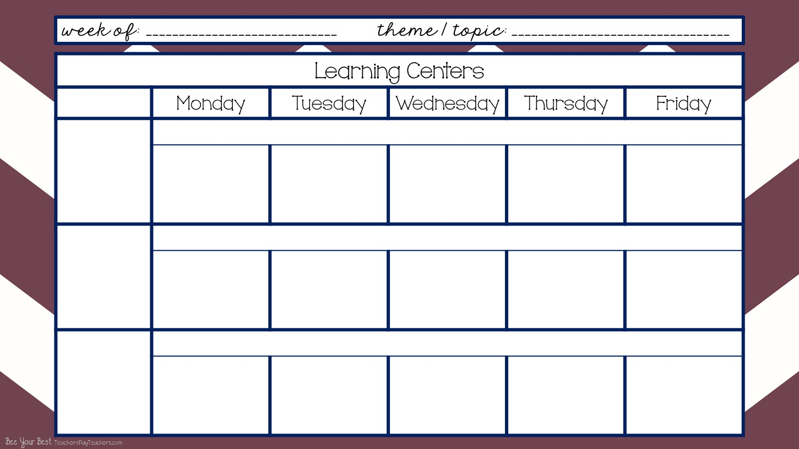
Wk# 3 -- Aug.31-Sept. 4,2020
Pete the Cat
Arrival & Free Play
8:40-9:40
I can become more independent. I can recognize and find my name and cubby. I can put my stuff away. I can choose an activity and friends to play with.
FOCUS - Letter Ll, #1, Square, & Blue
Pete the Cat color sheet
Letter L Paper
Pete the Cat color sheet
Letter L Paper
Letter L Paper
Clean Up
9:40-9:45
I can work with my friends and clean up and put things away then come to the carpet and get ready to learn altogether.
Community Carpet Time
9:45-10:10
I can sit on my spot on the carpet. I can listen to my teacher. I can keep my hands to myself. I can participate and learn.
ABC Rap Song
Square Song
Pete the Cat Twinkle Twinkle
This Is Your Land
Oklahoma
Letter L Rap
Blue Song
Shape Song Singing Walrus
You’re a Grand Old Flag
Oklahoma
ABC Rap Song
Square Song
Countdown to Blastoff
This Is Your Land
Oklahoma
Letter L Rap
Blue Song
Shape Song Singing Walrus
You’re a Grand Old Flag
Oklahoma
See It Say It Sign It
Shape Agent / Hunt
Pete the Cat Twinkle Twinkle
This Is Your Land
Oklahoma

Slide 2
Wk# 2-- August 24-28 , 2020
Chicka Chicka Boom Boom / All About Me
Morning Recess
10:10-10:40
I can play with my friends and share the equipment. I can play on the equipment correctly. I can line up when it’s time to go in.
Outside on Playground
(if there’s inclement weather then do rainy day boxes inside the classroom)
Mini Lessons
10:40-10:55
I can listen, learn, and participate in mini literacy, math, social skills, science, and social studies lessons.
Mini Literacy Lesson
Read Aloud
Class Discussion
Mini Math Lesson
Mini Literacy Lesson
Name of the Day
Mini Social Skills Lesson + Class Discussion / Anchor Chart
Mini Science / Social Studies Lesson -- use Weekly Reader + Class Discussion
Lunch
11:00-11:30 Afternoon Recess
11:30-noon
I can eat lunch and clean up my mess when I’m done. I can line up and walk to and from lunch and recess. I can keep my hands to myself and be nice to my neighbors.
Cafeteria & Outside on Playground
(if there’s inclement weather then do rainy day boxes inside the classroom)

Slide 3
Wk# 2 -- August 24-28, 2020
...
Chicka Chicka Boom Boom / All About Me
Smart Board Activity
noon-12:45
I can enjoy engaging Smart Board Activities while cooling down or warming up from being at recess. I will go to the bathroom and wash my hands. I will participate in smart board activities.
Color & Shape Monster Game
Smart Board / Brain Breaks
Who Took the Cookies from the Cookie Jar?
The Numeral Song with “air writers”
Who Took the Cookies from the Cookie Jar Name Activity
Work Stations / Center Rotations with Buddy
12:15-1:15
I can work with my work station buddy. I can share and communicate. I can clean up. I can put my papers away. I can learn the chart and move around. I can follow instructions. I can learn and grow!
Library -2- Thematic Unit Books
Shannon -4- Monday - Play Dough 10 Frames
Tuesday - Color Pete’s shoes correctly
NO Work Stations because it’s Early Out Day
Library -2- Thematic Unit Books
Shannon -4- Play Dough 10 Frames
Friday - Pete the Cat Popsicle Stick Puppets
Work Stations cont’d.
Math -2- Count & Clip Pete the Cat Math
Literacy -2- Trace Upper Case Letters Pete the Cat
NO Work Stations because it’s Early Out Day
Math -2- Trace #s Pete the Cat paper
Literacy -2- Highlight Lower Case letters Pete the Cat

Slide 4
Wk# -2 - August 24-28,2020
...
Chicka Chicka Boom Boom / All About Me
Work Stations cont’d.
Teacher Table -4- Monday - Pete the Cat Stepped In Journal Paper
Tuesday - 4 - Mud Pete the Cat Game
Blocks -2- Build & Create
Magnets - 2 Play with Pete the Cat colors / shoes
NO Work Stations because it’s Early Out Day
Teacher Table -4 - Roll the Dice and put a button on the matching number, practice counting and number skills
Blocks -2- Build & Create
Pocket Charts - 2 Play with Pete the Cat
.
I can eat and drink at snack time. I can wash up before and after snack. I can toss my trash.
Afternoon Snack
1:15-1:30
Wash Up -- Eat & Drink -- Clean Up & Toss Trash
Extra! Extra!
1:30 - 2:15
BIG GROUP -- Name of the Day
Weekly Reader
Re-Tell / Role Play Pete the Cat Story
Journals
White Boards
Cosmic Yoga -- Color Changing Experiment

Slide 5
Wk# -2 August 24-28, 2020
Chicka Chicka Boom Boom / All About Me
Pack Up & Get Ready to Go Home Daily Review
2:15-2:20
I can pack up my backpack and put on my jacket. I can sit on my square on the carpet and be kind to my neighbors. I can listen and learn.
Dismissal
2:20-2:30
I can line up and follow instructions of where to go and what to do from my teachers. I can be happy to go home!
Teacher Planning
2:30-3:40
I can plan awesome opportunities to learn and grow and be flexible as changes inevitably come.
PK
Grade Level
Mtg.

